Slide 1
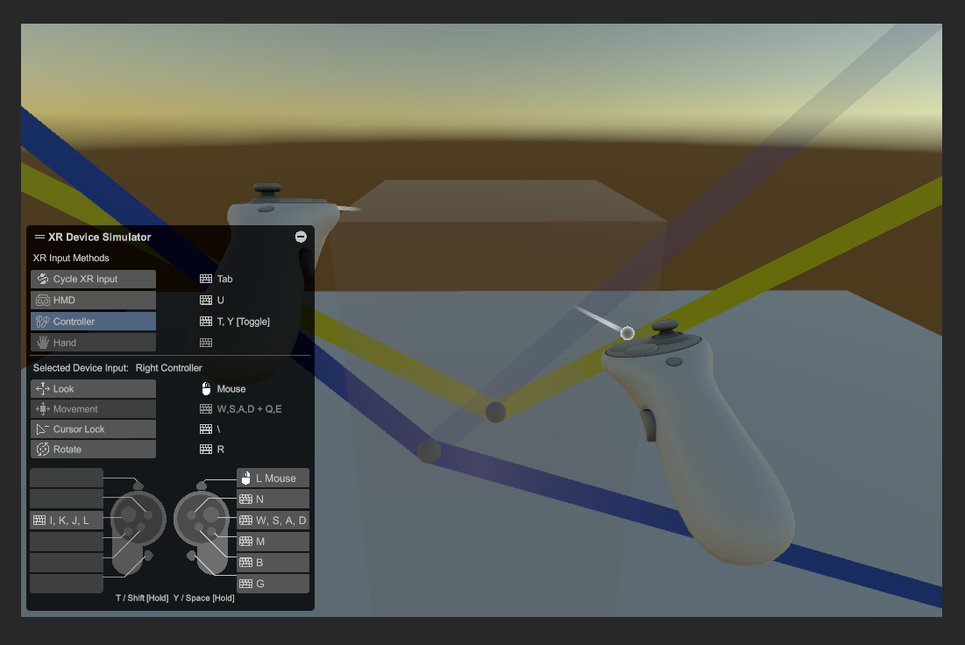
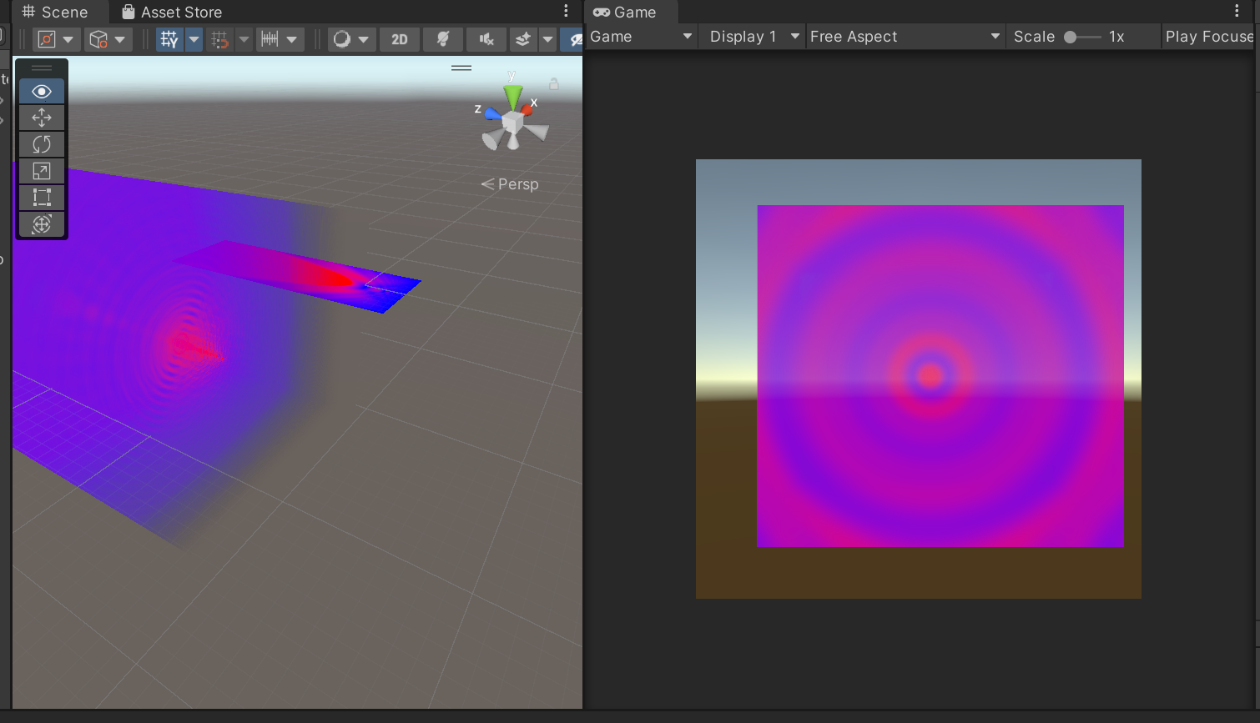
Fresnel Diffraction in 3D and VR - a basic draft of the app
Pucong Li
18.02.2025

Slide 2
Content
1. Definition of the task and aim of project
2. What has been achieved
3. Calcualtions that are need to be checked
4. Futher work

Slide 3
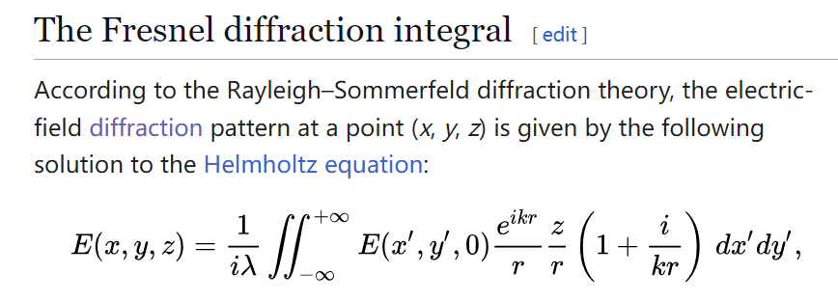
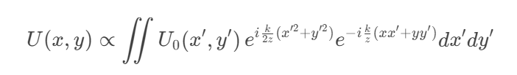
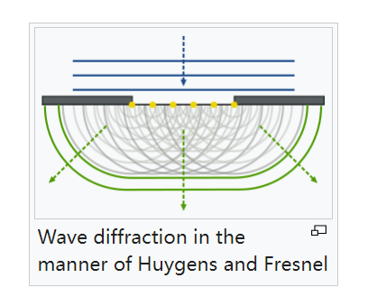
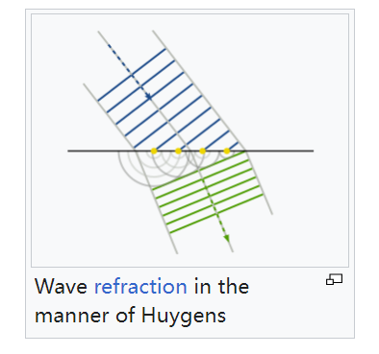
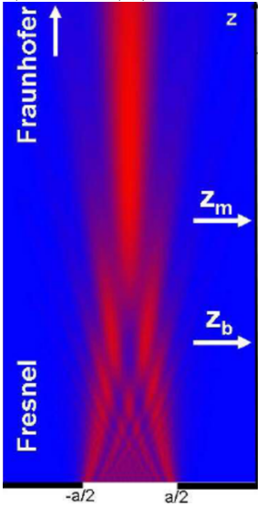
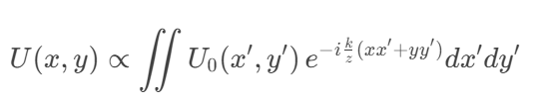
Definition of the task and aim
e^{iΘ=cosΘ+i*sin(Θ)}
Fresnel diffraction
approximation
Fraunhofer diffraction

Slide 4
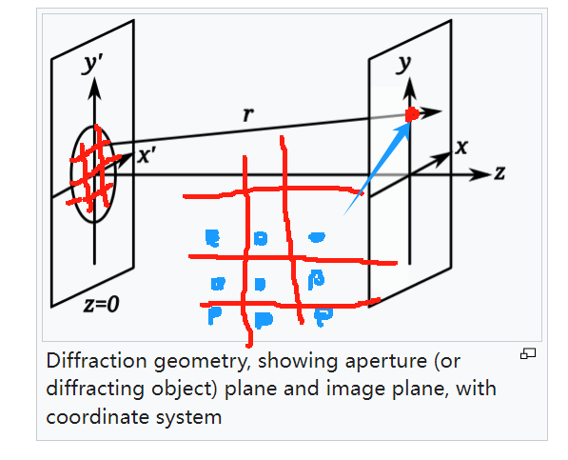
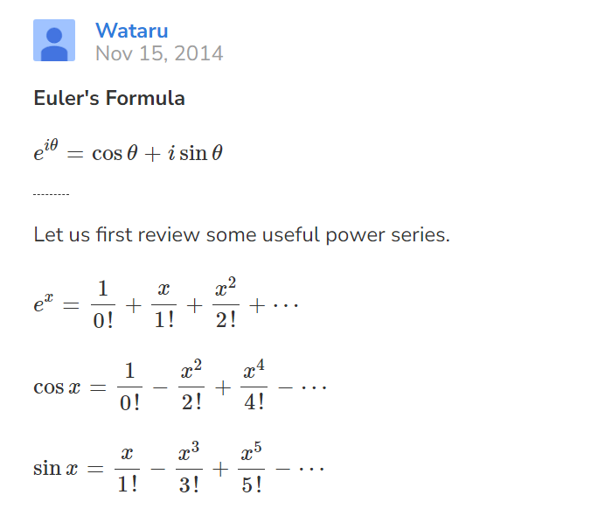
Definition of the task and aim
Fresnel diffraction
e^{iΘ}
Fraunhofer diffraction

Slide 5
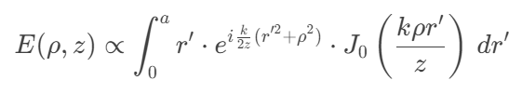
Definition of the task and aim
controller.cs could do futher calculations like 3D texture
Bressel approximation formula for interference terms
accumulate the real part and imaginary part of complex numbers
map intensity of light to colorspace, 3D data already in shader
discrete on 32 sample points on [0,a]

Slide 6
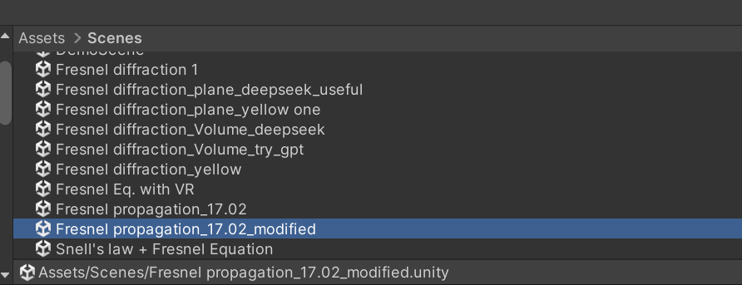
What has been achieved
Functions already achieved:
1. 3D visualization of the propagation field from Fresnel → Fraunhofer under ciucular aperture(2D data rotates 360° to get 3D, need strict prove?)
2. independent rendering of aperture diffraction pattern
What I have tried to solve the task:
1. Compute shader + Controller.cs to generate 3D texture for a material + (calculate double integral on each voxels, failed, 3D texture generated failed in inspector without error)
2. Some other tries on the rendering of material and texture and so on
3. VR streaming problem with my laptop, worked 1 year ago, but now still dark screen after 1 time of driver update

Slide 7
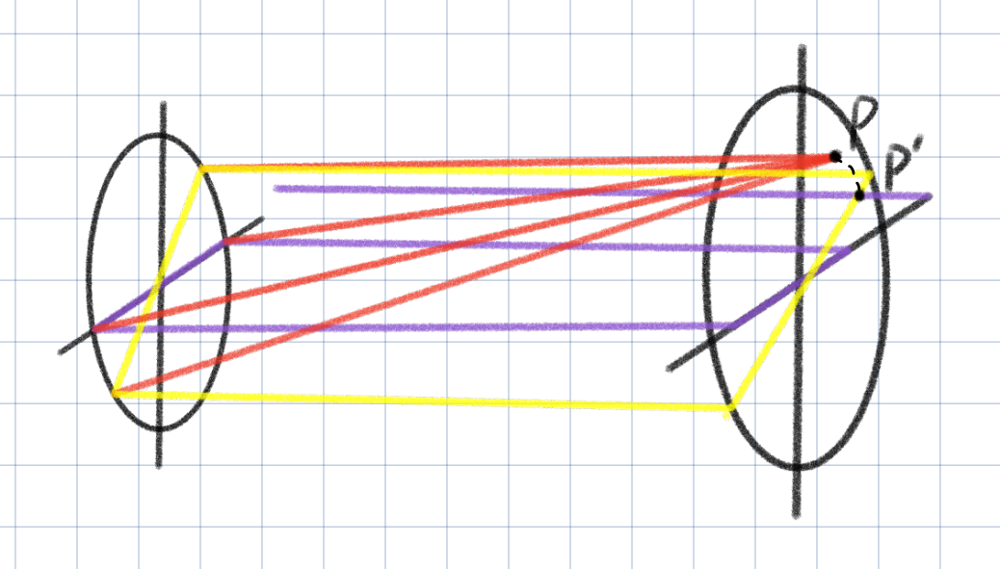
What has been achieved
Functions already achieved:
1. 3D visualization of the propagation field from Fresnel → Fraunhofer under ciucular aperture(2D data rotates 360° to get 3D, need strict prove?)
2. independent rendering of aperture diffraction pattern

Slide 8
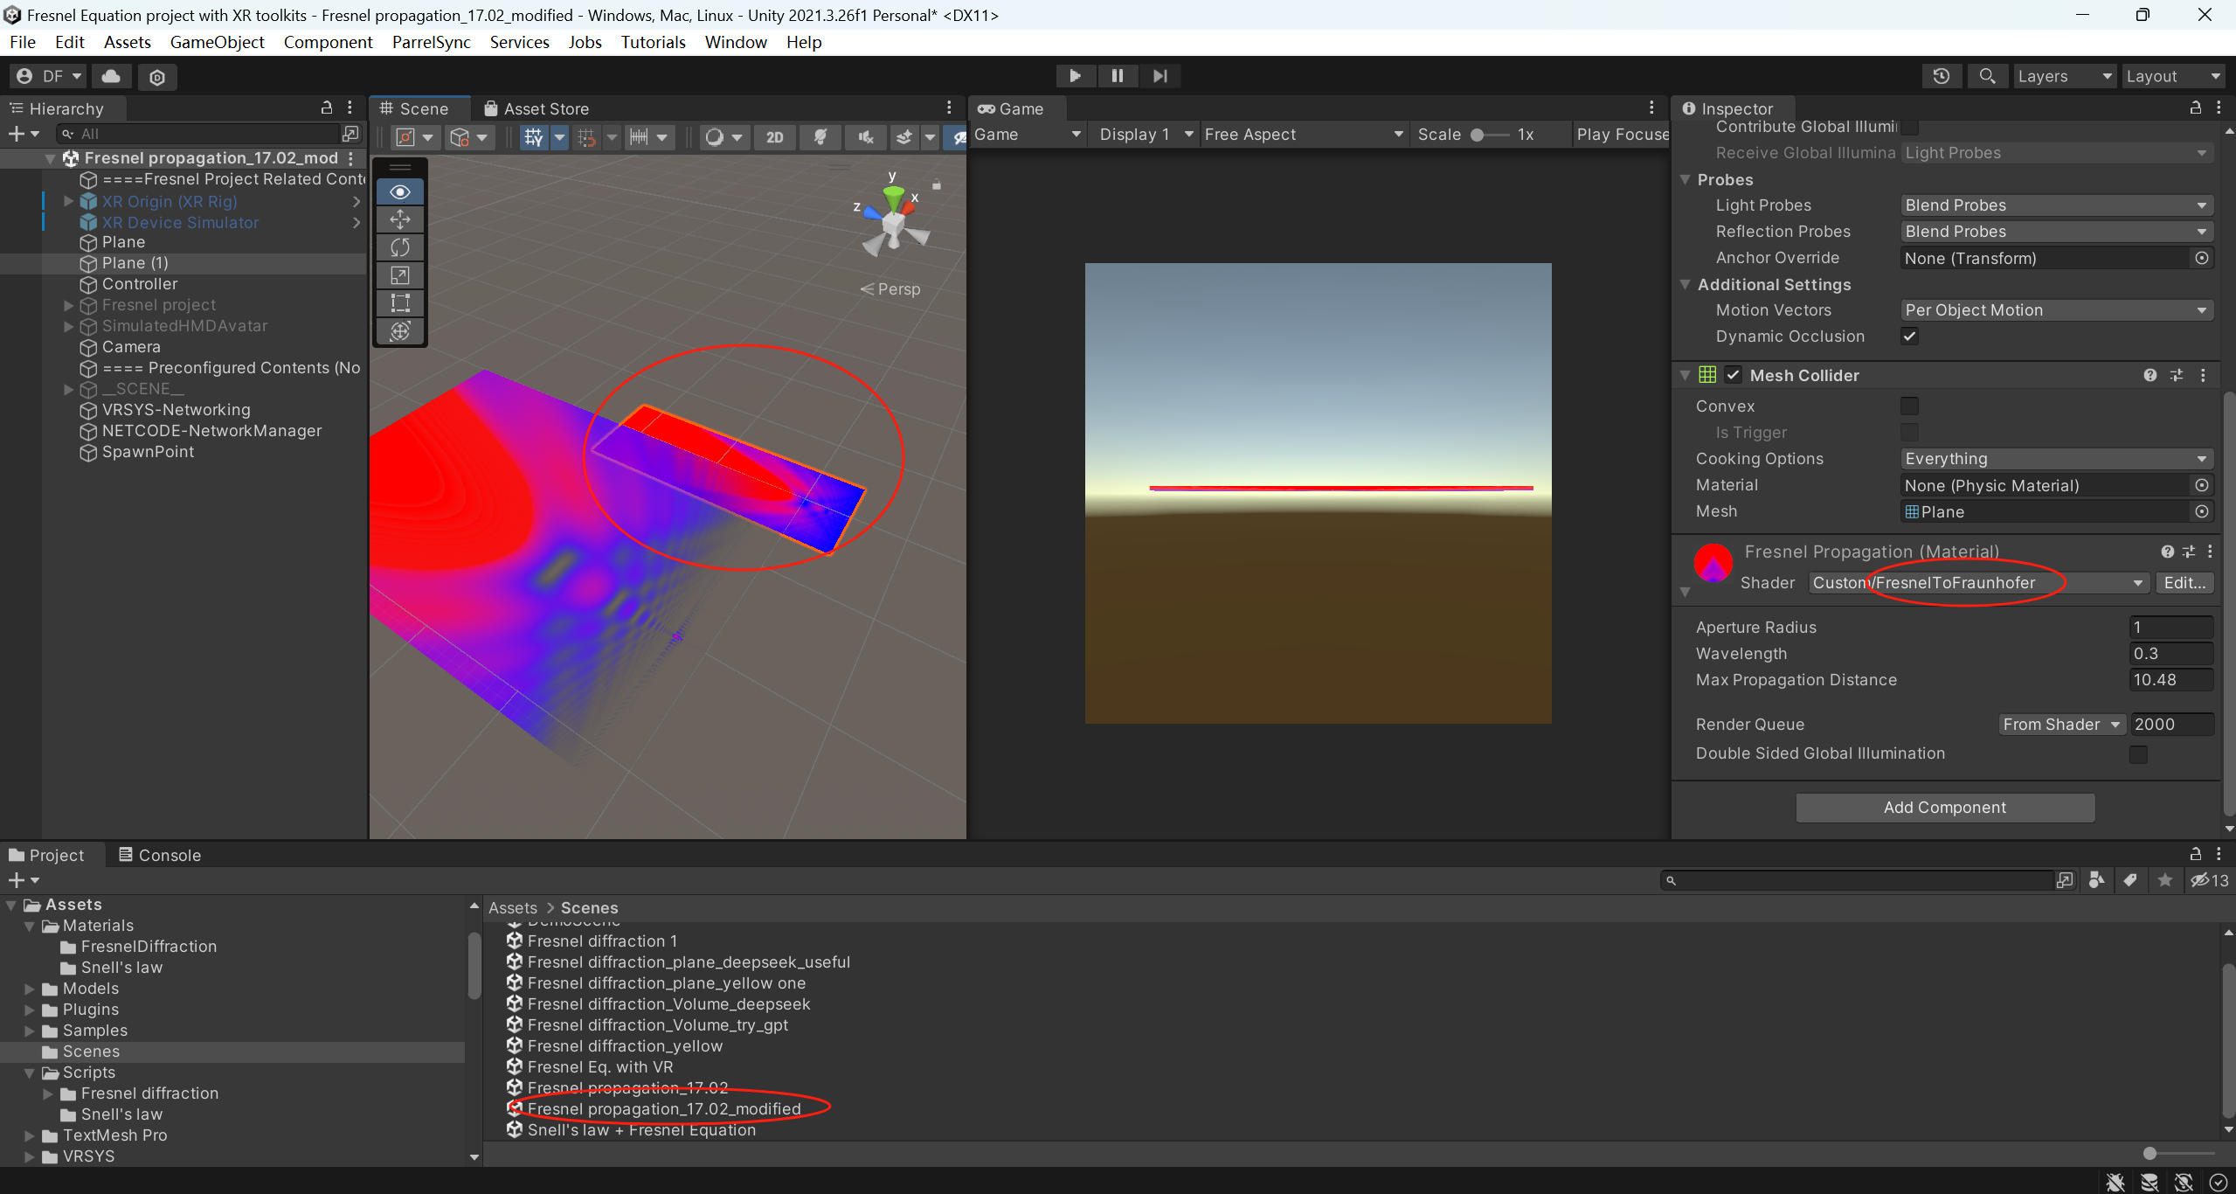
What has been achieved

Slide 9
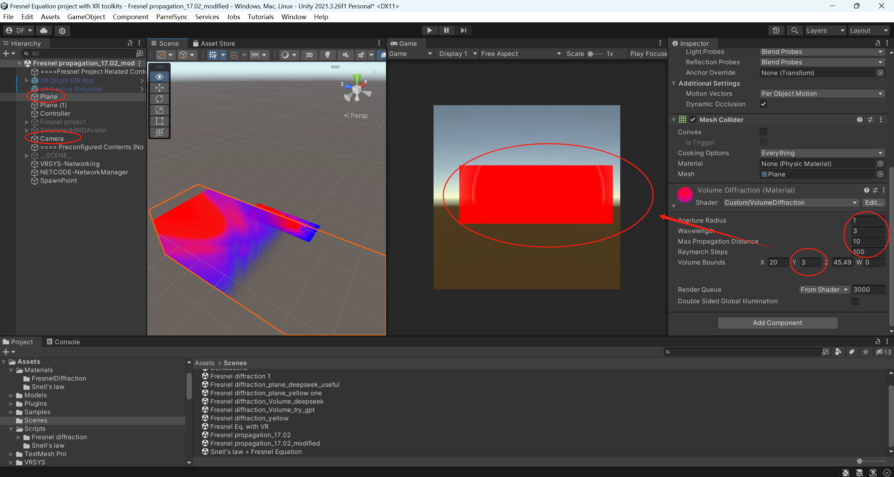
What has been achieved

Slide 10

What has been achieved

Slide 11
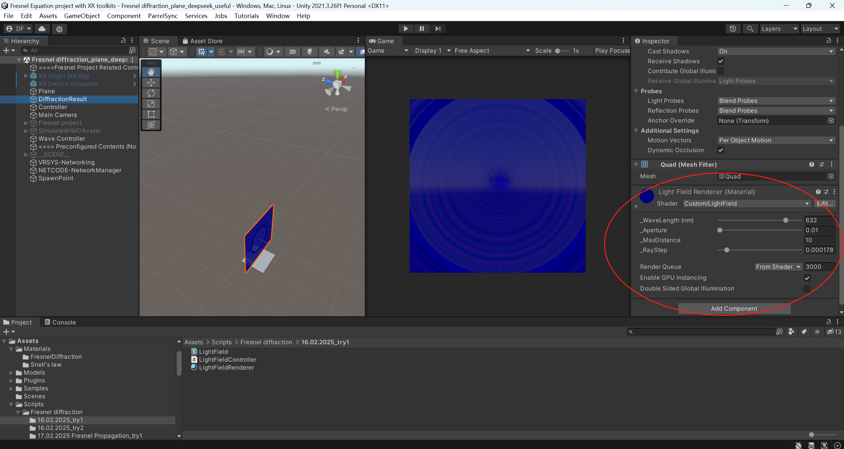
What has been achieved
accuracy looks not better, can be further modified

Slide 12
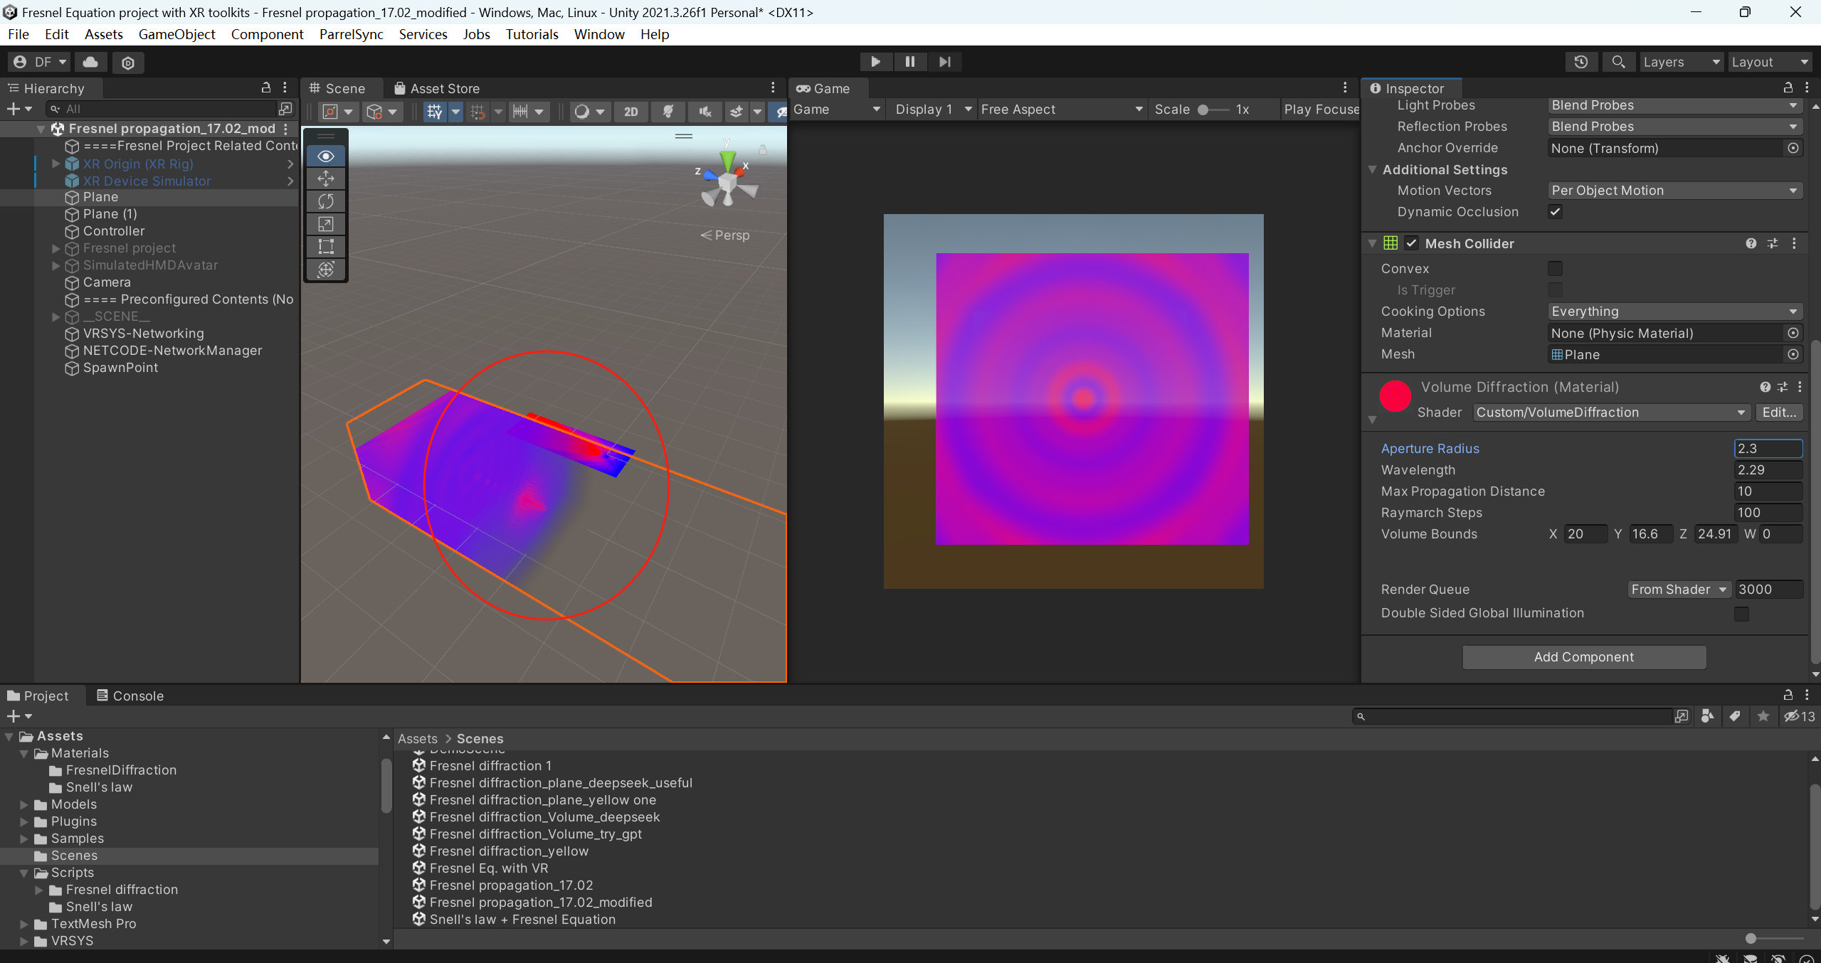
Calculations to be checked
transparent and superposition?

Slide 13
Further work
1. Concepts about shader, compute shader, 3D texture, and other advanced techniques like LOD..? Should I use shader to show the results?
2. interaction with VR
3. more types of obstacles like slits, and so on

Slide 14
Thank you for your attention!

